Slide 1
=> State Change
Constructor
_getListItems
getProjects
getUsers
getTimes
componentDidMount
userLoadStatus === "Complete"
userLoadStatus === "Complete"
projectsLoadStatus === "Pending"
timeTrackerLoadStatus === "Pending"
componentDidUpdate
_updateStateOnPropsChange
processProjects
processTime
onLinkClick
onNavClick
getTheseProjects
onShowDashboard
processChartData

Slide 2
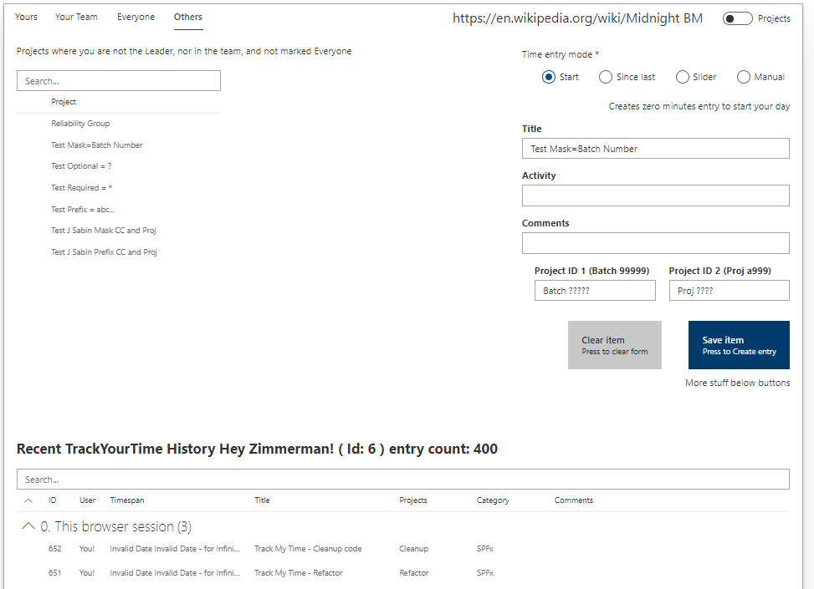
onLinkClick
toggleType
_updateEntryType
_updateTimeSlider
_updateStart
_updateEnd
_updateProjectTitle
_getSelectedProject
_updateActivity
_updateComments
_updateProjectID1
_updateProjectID2
clearMyInput
trackMyTime
processChartData

Slide 3
Scale
(Today, Yesterday, This week, This Month)
Count/Sum
Resolution
(Hours, Days, Weeks, Months)
Mon Tue Wed Thu Fri
Wk 5 Wk 6 Wk 8 Wk 8 Wk 9
Jan Feb Mar Apr May
Resolution

